Slide 1
Brass Tacks:
HCT and the Money Problem
R. Maziarz
AGFBT Meeting
10/20/2016

Slide 2
The GOOD
We have successes!!!!!!!!
Presentation with thanks to Working group, OHSU Leadership team

Slide 3
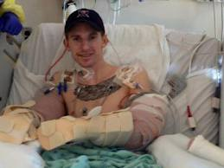
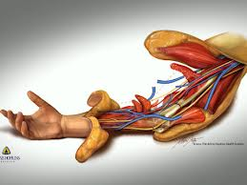

Novel Therapeutic Interventions:
Vascularized Composite Allotransplantation

Slide 4
Provider Principles
Primary goal is the direct delivery of care to patients
The patient is the center of our attention.
PT
4
Notes:
We focus on individual; and we are excited about progress and innovation on individual basis. We are not excited about big picture issues.

Slide 6
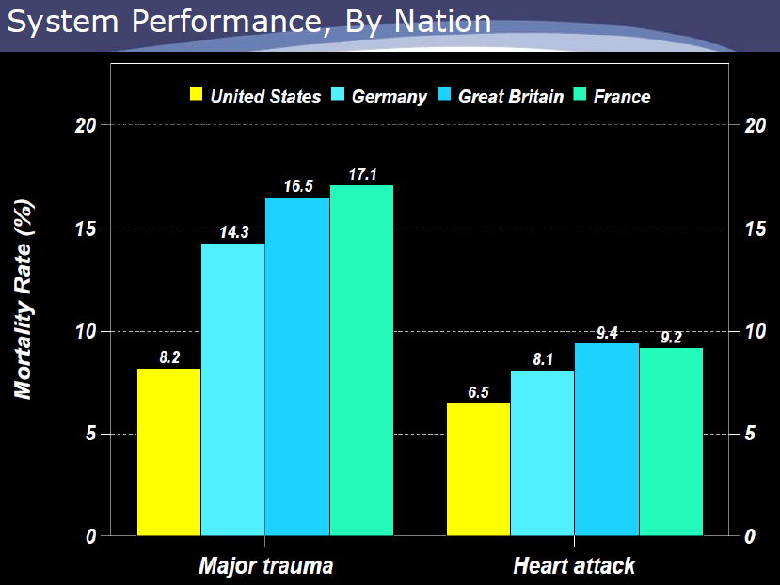
Factors that will decrease employer healthcare spending

Slide 7
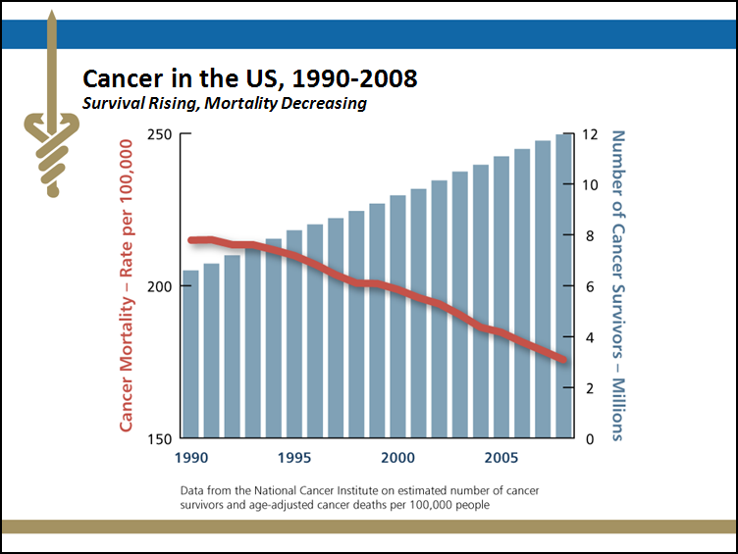


Slide 8
Where is the US going?
HCST as a model

Slide 9
HCT as Health Care Role Model
Only curative therapy for many diseases.
  Recognized by (most) payers as standard of care.
  Dramatic improvements in effectiveness/survival.
Ahead of the curve for health care reform:
  Bundled payment model = global case rate
  Quality/Value based networks (i.e. Centers of Excellence)
  Mandated reporting to central registry
  Public center-specific reporting of 1-year outcomes = Transparency of outcomes
True partnership with payers
  20 yrs joint discussions: Demonstration Project
  Active, engaged payer Advisory Group
  Co-author publications, develop unifying standards

Slide 10
Needs Analysis
By applying the optimal transplant rate to the U.S. population, the need for allogeneic (related and unrelated) transplant is 18,000 per year.
Related – 5,500 per year
Unrelated – 12,500 per year
    2011 = ~5,000 per year
    2005 = ~2,500 per year
The NATIONAL MARROW DONOR PROGRAM® operates the Be The Match Registry®.
Notes:
The NATIONAL MARROW DONOR PROGRAM® operates the Be The Match Registry®.

Slide 11
THE BAD
How do others view what we do?

Slide 12
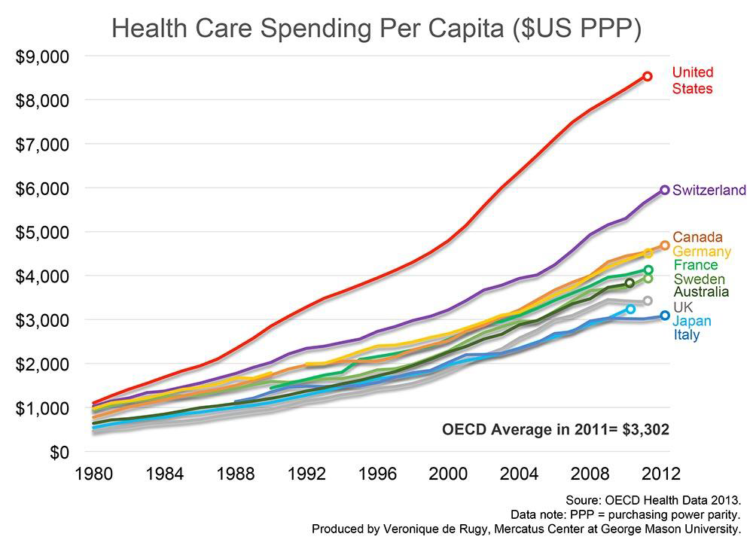
The ACA has had minimal impact on employer health costs

Slide 13
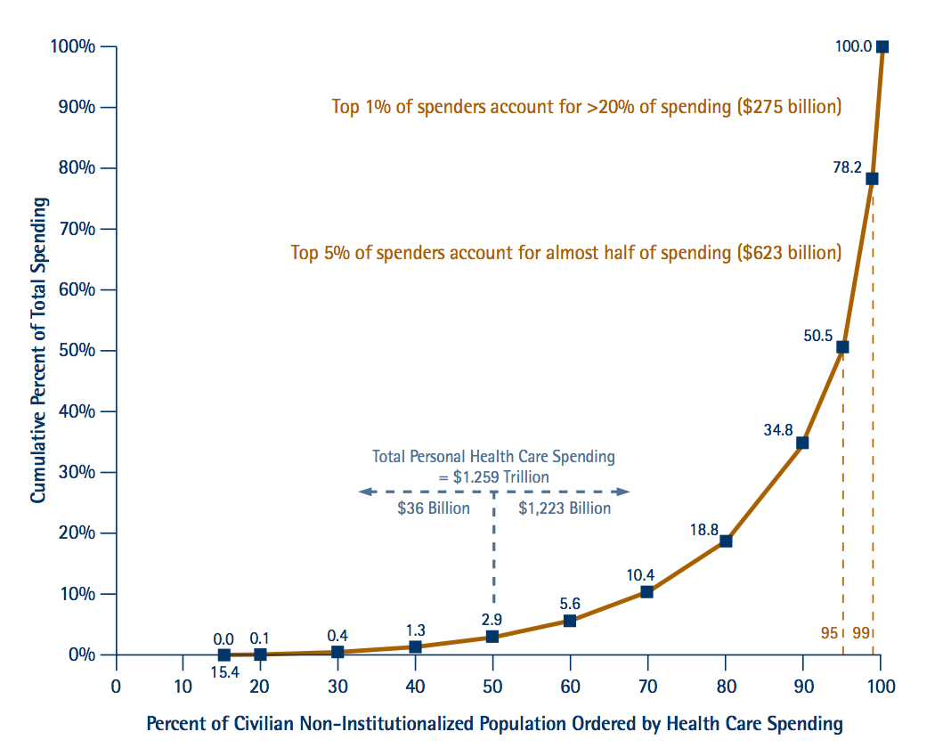
Factors that will decrease employer healthcare spending

Slide 14
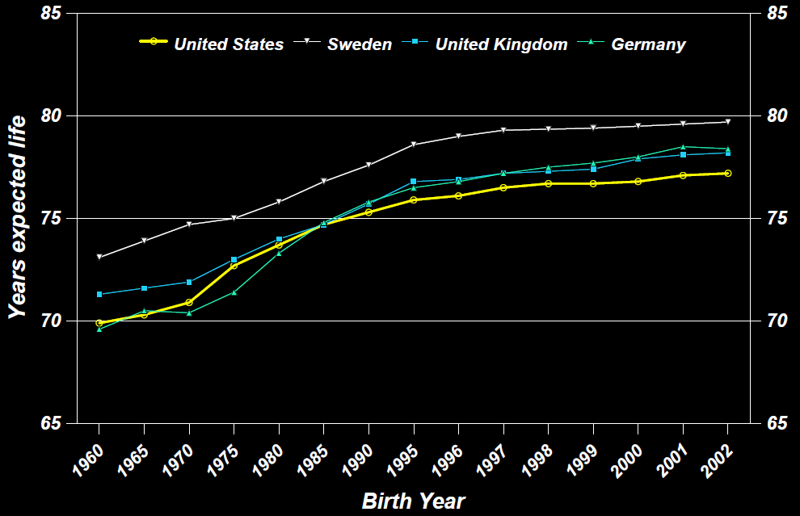
Life expectancy at birth – by birth year

Slide 15
Costs of Cancer Care
U. S. National cancer care expenditures were an estimated $124.6 billion in 2010
Underestimate of total impact which may approach $350 billion

Slide 16
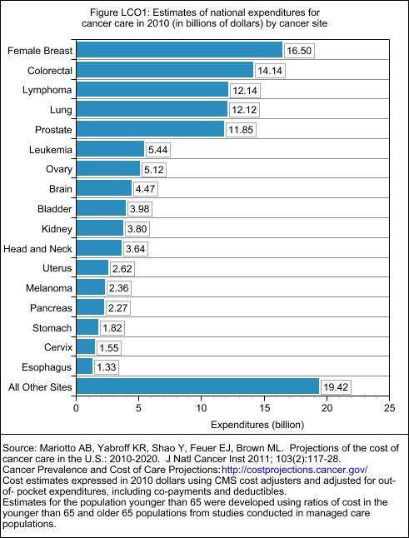

Slide 17

Factors that will increase healthcare spending
  Specialty drugs (e.g. biologics, MAb’s, etc.)

Slide 18
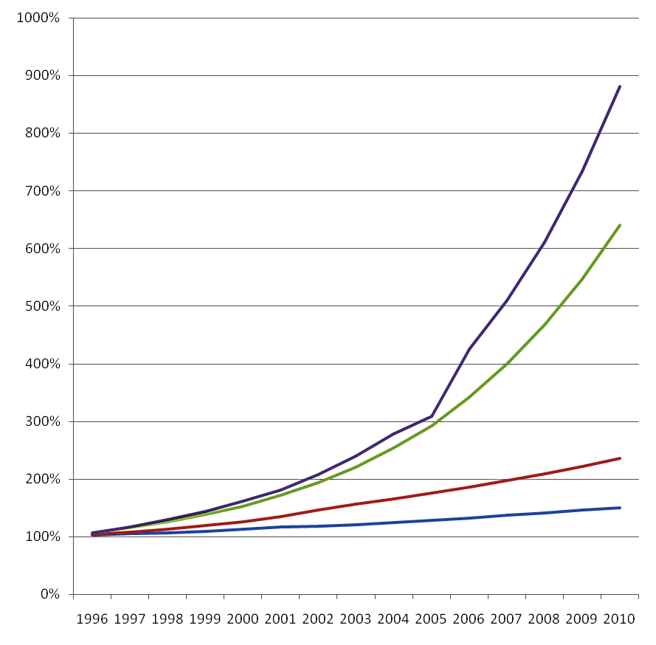
Cancer care costs rising faster than overall healthcare:
Cancer costs account for approximately 5% of US health care spending
Cancer Drugs
Cancer Medical
Healthcare
US GDP
Source: Blue Cross Blue Shield Association
Notes:
18
While we may not represent the largest expenditure, we are the fastest growing.
Cancer costs account for approximately 5% of US health care spending, and that proportion will likely continue to increase as patients with cancer live longer with their disease and thus consume a greater share of US health care dollars. According to the National Institutes of Health, the United States spent more than $89 billion on cancer care in 2007, with a total economic burden of $219.2 billion, including the indirect costs of reduced productivity and death.
The cost associated with new technologies such as robot-assisted surgery, advanced imaging techniques, sophisticated radiation treatment options, and the introduction of new therapeutic drugs have all driven up the cost of cancer care. More than $19 billion (> 21.3% of cancer care spending) was spent on drugs alone in 2007.⁸
The cost associated with new technologies such as robot-assisted surgery, advanced imaging techniques, sophisticated radiation treatment options, and the introduction of new therapeutic drugs have all driven up the cost of cancer care. More than $19 billion (> 21.3% of cancer care spending) was spent on drugs alone in 2007.⁸
18

Slide 19
Current backlash against drug costs
Americans overpaying hugely for cancer drugs – Reuters: Tue Sep 22, 2015 Several widely-used TKIs are expected to become available as generics within the next five years, as patents expire. Hill calculated that large-scale production could achieve treatment prices in the range of $159 to $4,022 per person a year, vs current U.S. prices of around $75,000 to over $100,000. On this basis, he found that Novartis' leukemia drug Glivec actually cost $159 for a year's treatment, against the $106,000 charged in the United States.
How Clinton Hopes to Make American Drug Prices Sane Again
Re: Daraprim—a drug acquired by the startup Turing -overnight price increase of 5,000 percent. “Price gouging like this in the specialty drug market is outrageous. Tomorrow I'll lay out a plan to take it on. -H https://t.co/9Z0Aw7aI6h;” — Hillary Clinton (@HillaryClinton) September 21, 2015
Her tweet set off a 5 percent drop of the index that extended for more than two hours

Slide 20
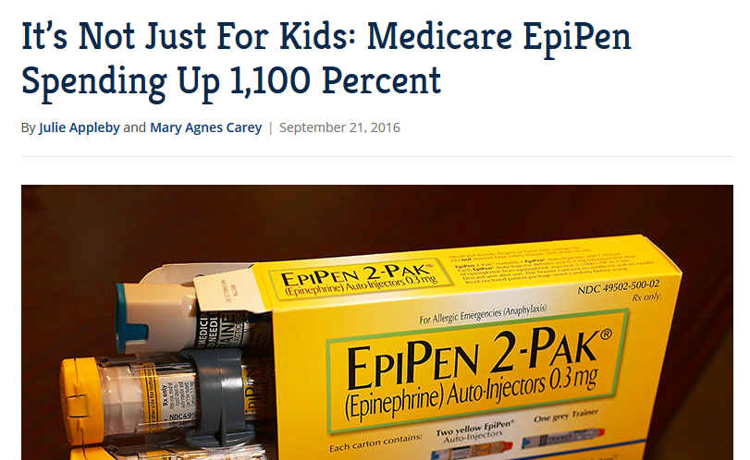
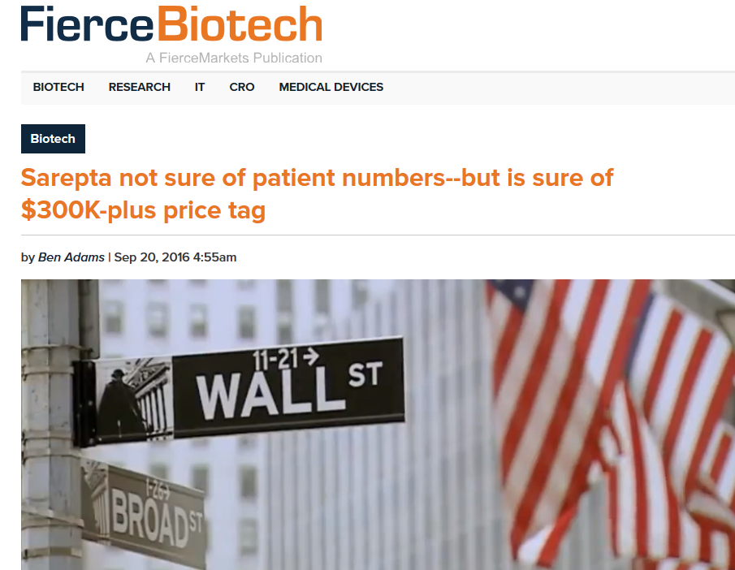
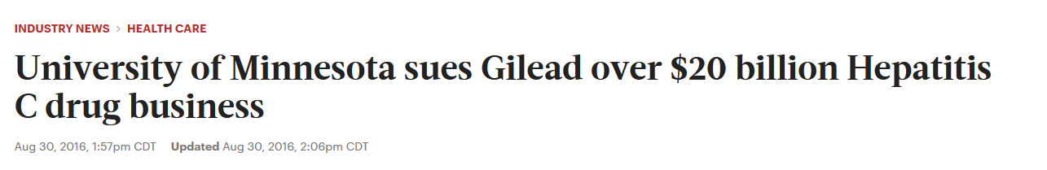
Baseline: Big Price Tags Bring Big Problems

Slide 21
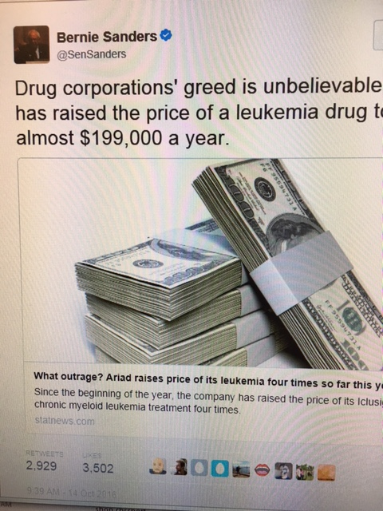
With a single tweet, Sen. Bernie Sanders cost Ariad Pharmaceuticals $387 million. As a result of Sanders’ tweet, Ariad stock ended the day down by 14.8 percent, falling to $11.14 a share. In a statement, Ariad argued that “our pricing reflects our significant investment in R&D, our commitment to the very small, ultra orphan cancer patient populations that we serve and the associated risk with research and development.”

Slide 22
Baseline: Big Price Tags Bring Big Problems
From ads for Cell Therapy Manufacturing & Gene Therapy Congress (10/11/16):
As drug makers including Novartis, Juno Therapeutics and Kite Pharma race to launch what may be the most effective treatments ever seen for leukaemia and other blood cancers, they are grappling with how to make them widely available in a reliable and cost-efficient way.
Industry analysts expect CAR T cell therapies will begin to reach the market in 2017 and command prices of up to $450,000 if such remarkable results are replicated in larger trials. The cost is for a one-time application after which, if it works, signs of the cancer are eliminated and the patient needs no more treatment.
CAR-T : Drug or Procedure??????????????????

Slide 23
What’s coming????
Science. 2016 Jul 8;353(6295):179-84. doi: 10.1126/science.aaf6756. Epub 2016 Jun 30.
Reengineering chimeric antigen receptor T cells for targeted therapy of autoimmune disease.
Ellebrecht CT¹, Bhoj VG², Nace A¹, Choi EJ¹, Mao X¹, Cho MJ¹, Di Zenzo G³, Lanzavecchia A⁴, Seykora JT¹, Cotsarelis G¹, Milone MC⁵, Payne AS⁶

Slide 24
Emerging marketplace trends

Slide 25
Trends you can count on . . .
  Medicare is moving quickly to value-based care
  Shift from care of “the individual” only to also putting them in context of the health of a population
  Identification of budgets to care for a population will become more prominent, and FFS will become an increasingly smaller part of medical practice
  Identification of preferred care delivery methods will increasingly be informed by the consumer/end user; no longer 9-5
  Medicine is clearly going the way of banking, travel, and entertainment; i.e. consumer-directed

Slide 26
What is happening in the Payor industry??
Demand for Value & Quality
Pathways
Centers of excellence
Transparency demands
Consolidation

Slide 27
Not All Health Plans Are The Same…
Smaller company= generally less coverage
Contract Language
  Terminology (“experimental/investigational”)
  Explicit exclusions
Approach to determining medical appropriateness
Relationship with, and involvement of physicians in the process
“Exceptions” and appeals processes

Slide 28
Health insurance consolidation
“Big Five” health insurers → “Big Three”*
Aetna + Humana = 33 million members
Anthem + Cigna = 53 million members
UnitedHealth Group = 45 million members
  Total: 131 million members
*Justice Department has filed suit to block Aetna-Humana and Anthem-Cigna mergers

Slide 29
Non profit health care systems consolidation
Providence (NW) merger with St. Joseph Health (CA)
Becomes the 3rd biggest non-profit health system in the U.S.:
  After Kaiser Permanente and Ascension Health
  2 of the 3 largest are in our local marketplace
Before | After
5 states | 7 states
34 hospitals | 50 hospitals
82,000 employees | 110,000 employees
$14 billion | $20 billion

Slide 30
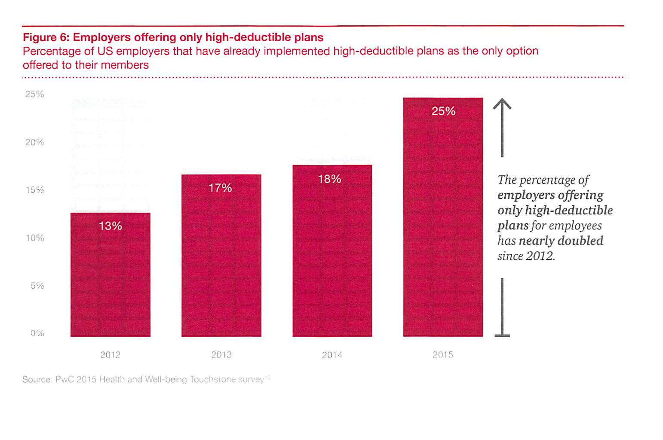

Slide 31
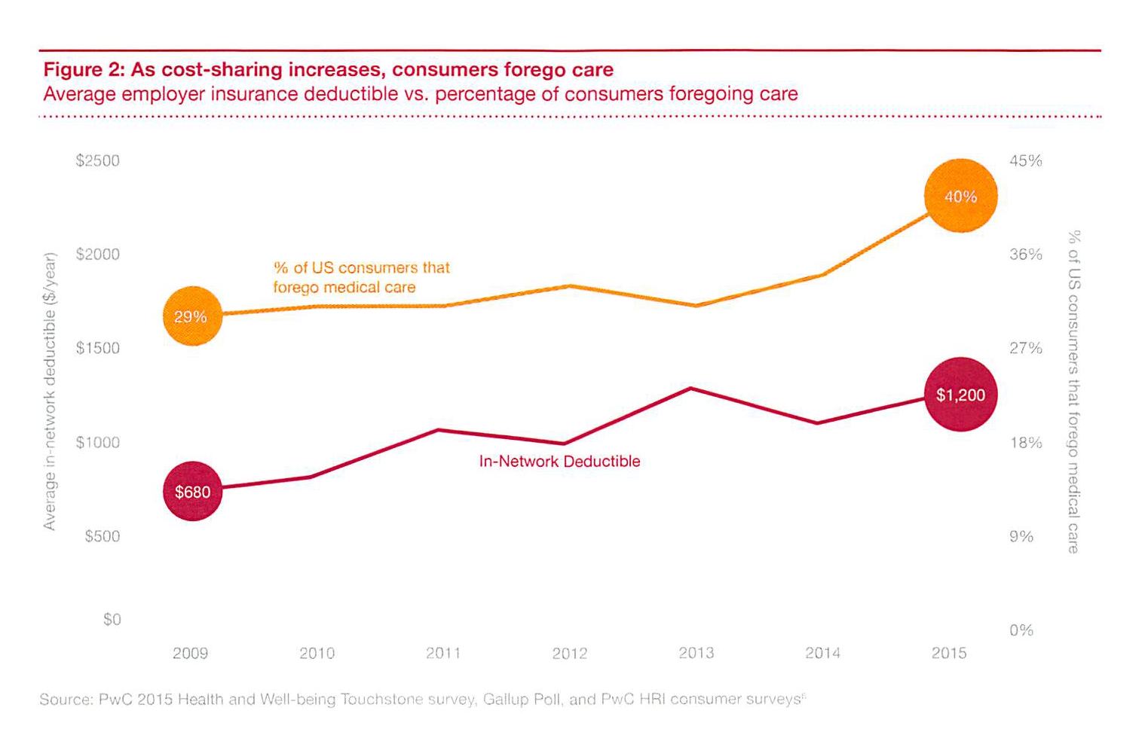

Slide 32
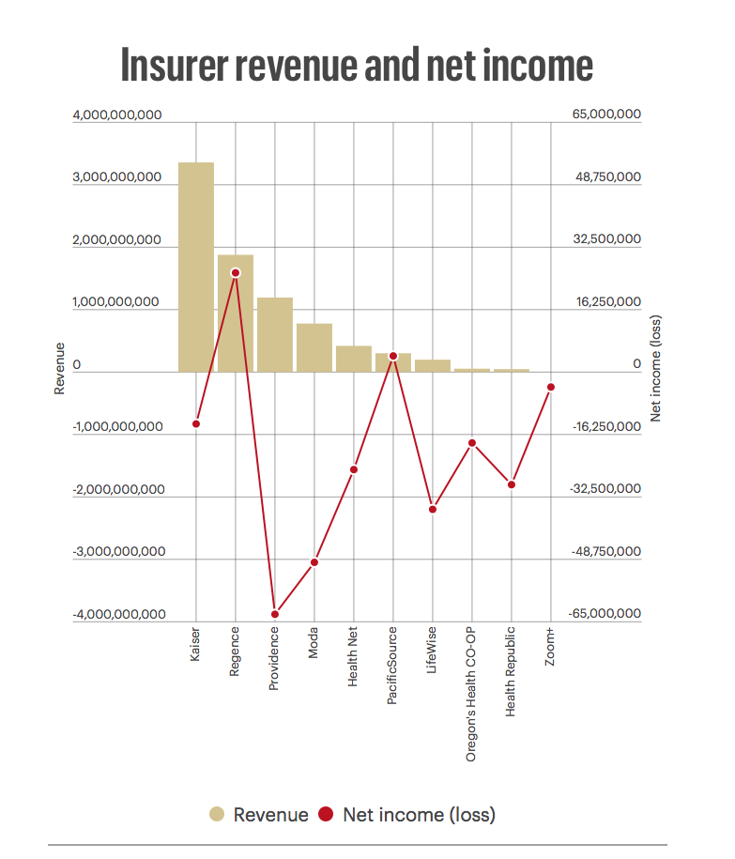
Most Oregon health insurers posted losses in 2015
Portland Business Journal
March 2, 2016

Slide 33
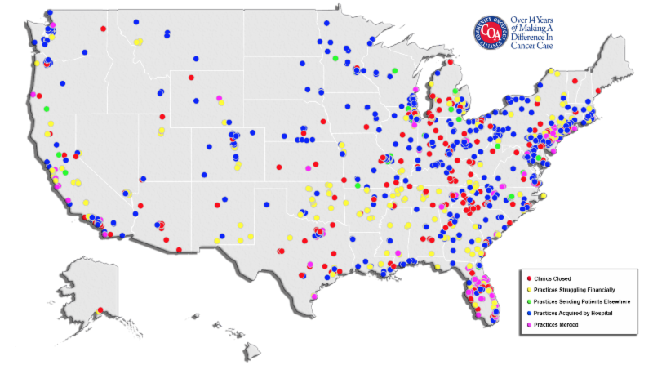
Evolution of Oncology Practices

Slide 34
Everyone is watching outcomes
Value & Quality Metrics
Evidence matters!!!
Cost effectiveness research
Comparative effectiveness research

Slide 35
Five Year Direct Cost of Pediatric Patients with Acute Lymphoblastic Leukemia Undergoing Allogeneic Stem Cell Transplantation: an Analysis from US Payers’ Perspective
Richard T. Maziarz, M.D.¹; Annie Guerin, M.Sc.²; Genevieve Gauthier, Ph.D.²; Julie Heroux, M.Sc.²; Masha Zhdanava² ; Eric Q. Wu, Ph.D.²; Simu K. Thomas, Ph.D.³; Lei Chen, M.D., Ph.D.³
¹ Center for Hematologic Malignancies, Knight Cancer Institute, Oregon Health & Science University
² Analysis Group Inc.,
³ Novartis Pharmaceuticals Corporation
This study was funded by Novartis Pharmaceutical Corporation
Presented at the 57th ASH Annual Meeting December 7th, 2015

Slide 36
Total Healthcare Costs
Figure 2: Total Healthcare Costs (Mean)
n = 128
n = 196
n = 209
n = 73
n = 46
Period following the HSCT
** Costs for the first 100 days and Year 1 include the HSCT hospitalization costs
Notes:
Healthcare costs were measured from private payers’ perspective and therefore reflected the claims reimbursed by the private payers. Costs were adjusted for inflation using the Consumer Price Index for medical components and reported in 2014 US dollars (USD).
Consistent with healthcare resource utilization, patients incurred substantial healthcare costs following the HSCT.
During the first 100 days and the first year following the HSCT procedure, patients incurred an average total healthcare cost of $509,520 ± 406,114 (median of $374,715) and $683,099 ± 550,283 (median of $511,021), respectively.
The HSCT hospitalization costs represented 62.4% ($426,128) of the total healthcare cost incurred during the first year following the HSCT procedure.
Total healthcare costs were mainly driven by medical service costs (98.4% in the first year following the HSCT date), with IP and OP costs making up 83.1% ($558,670) and 13.0% ($87,317) of the medical service costs in the first year following the HSCT date, respectively.
Although a decreasing trend was observed over time, healthcare costs remained high; average total healthcare costs was $104,584 (median of $21,877) at year 2, $79,092 (median of $11,000 ) at year 3, $106,334 (median of $10,426) at year 4 and, over the fifth year following the HSCT date, patients had an average total healthcare cost of $38,291 (median of $10,082). IP costs remained the main driver of total medical services costs for year 2, 3 and 4, while OP and laboratory costs were the main drivers in the fifth year following the HSCT date.
Median costs:
HSCT hospitalization: $304,341
First 100 days: $374,715
Year 1: $511,021
Year 2: $21,877
Year 3:$11,000
Year 4:$10,426
Year 5:$10,082

Slide 37
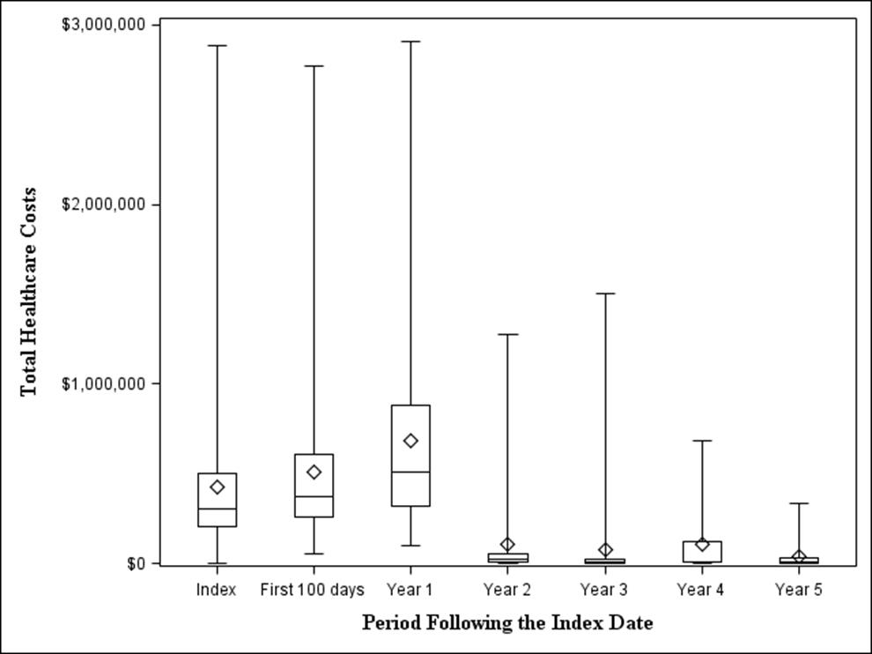
Distribution of Total Healthcare Costs
High variation in healthcare costs across individual patients; a small proportion of patients account for the majority of the total costs
Notes:
Findings suggest a high variation in healthcare costs across pediatric patients following the HSCT.
A small proportion of patients still incur very high costs several years after HSCT
In the first year 29.4% of the total costs (over the entire sample of patients) were incurred by the 10% patients with the highest costs.
Starting from second year following the HSCT the 10% patients with highest costs accounted for 61.3% to 76.6% of the total healthcare costs for each year

Slide 38
Where will be in 5 years?
  Care will be more continuous, collaborative with the patient, and increasingly non-visit centered-
  telemedicine
  Coverage will still largely be employer-based, but there will be a clear move to defined contribution and then letting the market work
  Medicare, Medicaid and Public Employee plans may increasingly converge; exchanges will continue to increase around ACO’s and CCO’s
  There will not be a single payer, and commercial insurance will not go away, but it will be a much smaller portion of the market

Slide 39
Where will be in 10 years?
  Outcomes will be better
  Interdisciplinary team-based care, based on readily available evidence, will improve provider’s job satisfaction and performance
  Patients will have access to much more medical information and be better informed; they will change their relationship with physicians and other providers to one of a “partner and trusted advisor” in decision-making about their health

Slide 40
Getting Down to Brass Tacks
Brass tacks are a type of pin or nail, sometimes called a drawing pin. In colloquial English, the phrase to get down to brass tacks is an idiom that means to focus on essential details, such as measuring out the precise amount of an item for sale.
Brass Tacks for the AGFBT = What’s the societal ROI?
  What’s the value of HCT
  How do we pay for it?

Slide 41
What is Value?
Value proposition= Expensive, but potentially curative
Value = Quality/Cost
Value= Health outcomes that matter to patient
Cost of Delivery
Adapted from Porter 2015

Slide 42
Understanding the Components
Health Outcomes that Matter to Patients
  Survival – OS and PFS
  Self-reported QOL
  Return to work/normal
  Financial Toxicity
Cost of Care Delivered
  Claims data analysis
  Evidence-based care
  Waste/Inefficiencies
HSR Working Groups, PCORI Efforts
HSR/HE SIG Efforts
Research, Guidelines
AGFBT Subgroup

Slide 43
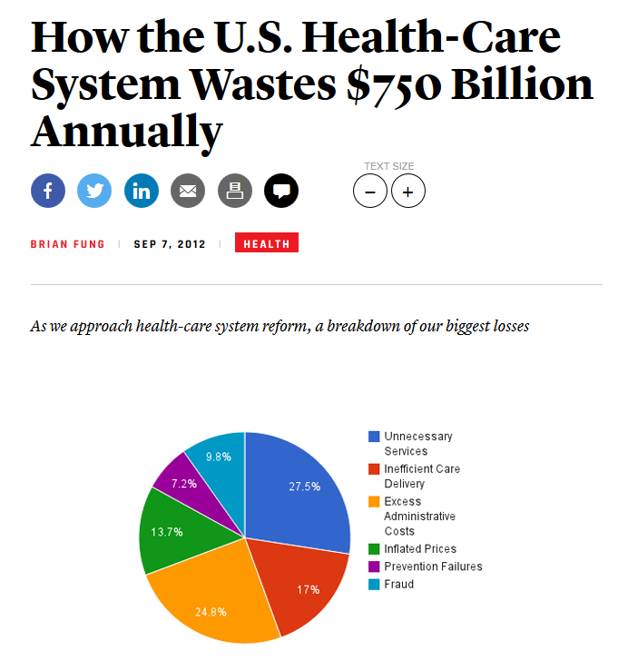
Defining Waste
American Society for Quality (ASQ) =
“healthcare services that do not add value or improve patient outcomes”
BE LEAN!!!!!!

Slide 44
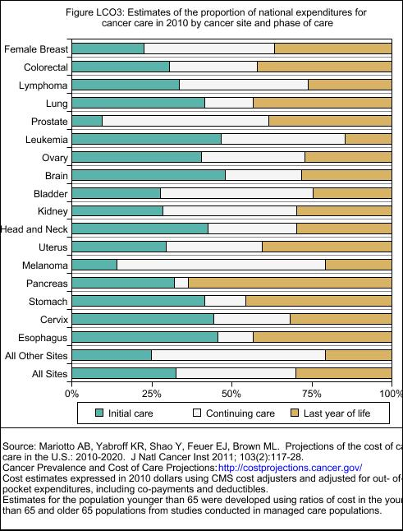

Slide 45
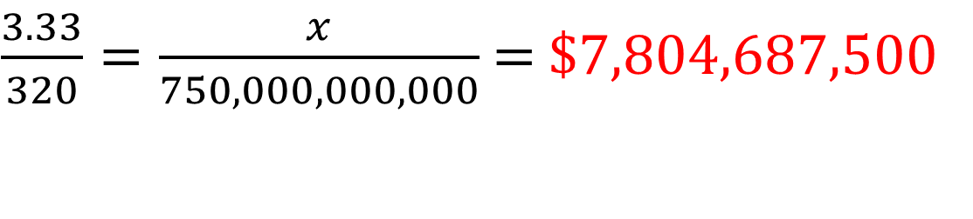
Can we identify how much inefficiency exists in HCT?
Starting Points:
Estimate of Auto and Allo HCT charges PMPM = $3.33 (Milliman)
Total average monthly spend PMPM = $320 (2010 LifeLink)
$750 Billion in Waste (IOM)
Assume proportion of spend on HCT = proportion of waste
$\frac{3.33}{320}=\frac{x}{750,000,000,000}$ = $7,804,687,500

Slide 46
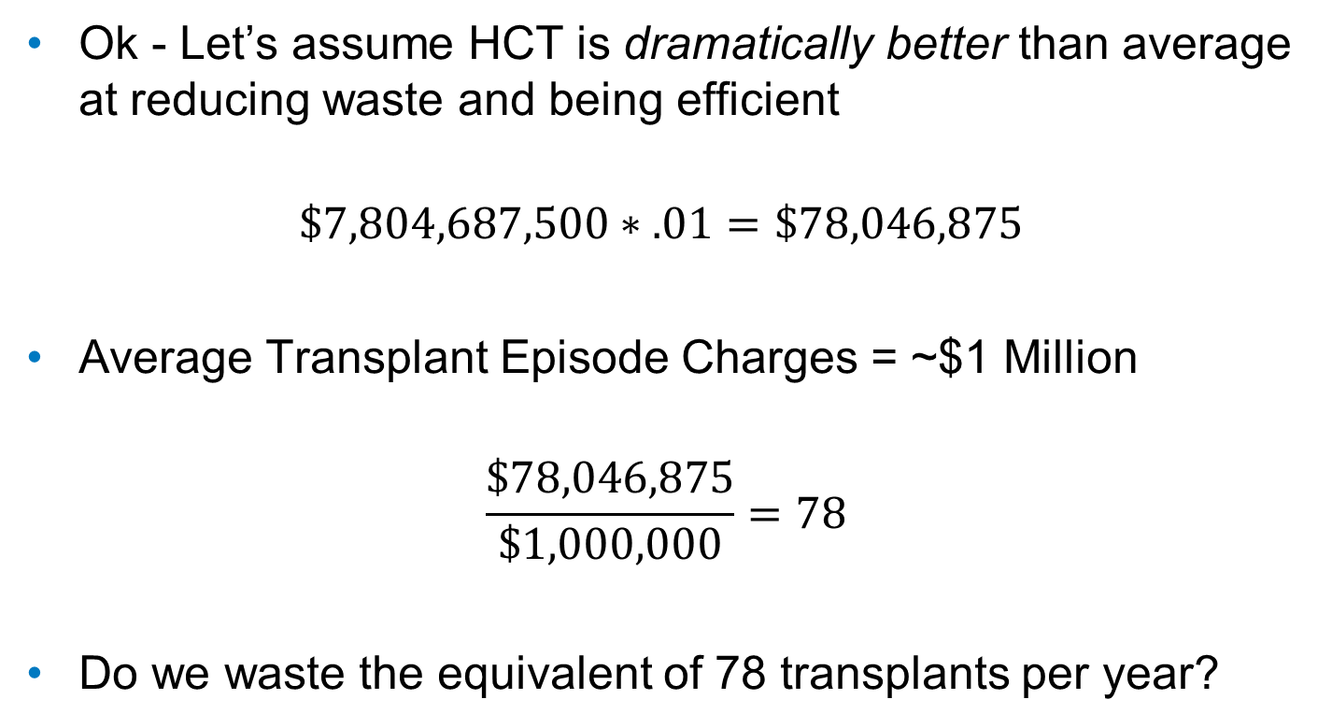
$7,804,687,500 Seems Rather Dramatic
Ok - Let’s assume HCT is dramatically better than average at reducing waste and being efficient
$$\$7,804,687,500∗.01=\$78,046,875$$
Average Transplant Episode Charges = ~$1 Million
$$\frac{\$78,046,875}{\$1,000,000}=78$$
Do we waste the equivalent of 78 transplants per year?

Slide 47
Categories of Waste
Failures of Care Delivery
Adverse Events, HAIs, Misdiagnosis
Failures of Care Coordination
Readmission, Decline in Functional Status
Overtreatment
Defensive medicine, provider preference, futile care
Administrative Complexity
Unstandardized forms and procedures
Pricing Failures Above market value for no reason
Fraud and Abuse
Health Affairs (2012)

Slide 48
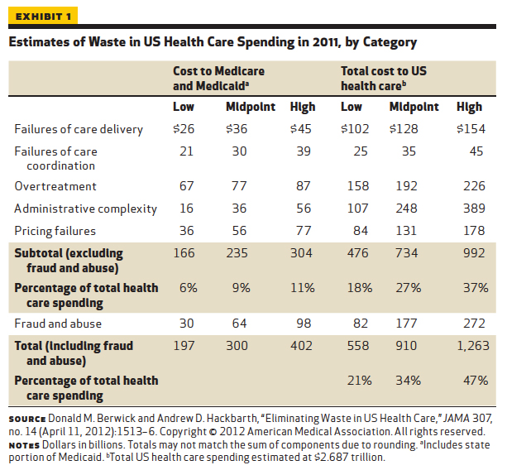
""Health Policy Brief: Reducing Waste in Health Care," Health Affairs, December 13, 2012.
http://www.healthaffairs.org/healthpolicybriefs/

Slide 49
Can we complete the matrix for HCT?
No, but we can guess…
Category | Low | Midpoint | High
Failures of Care Delivery | X
Failures of Care Coordination |  |  | X
Overtreatment |  | ?
Administrative Complexity |  |  | X
Pricing Failures |  | ?

Slide 50
HCT-Specific Potential Categories
Labs
Medications
LOS variation
Variation in patient selection
Variation in donor selection
Care-setting variation (IP vs OP)
Time to consult/Time to Transplant
Examination of Outliers – Commonalities?

Slide 51
IOM Recommendations on
Countering Waste
“ICU clinicians have 180 activities per patient per day”
Improve providers' capacity to collect and use digital data to advance science and improve care.
Involve patients and their families or caregivers in care decisions.
Use clinical practice guidelines and provider decision support tools to a greater extent.
Promote partnerships and coordination between providers and the community to improve care transitions.
Improve transparency in provider performance, including quality, price, cost, and outcomes information.
Realign financial incentives to promote continuous learning and the delivery of high-quality, low-cost care.
IOM, September 2012

Slide 52
Realigning Financial Incentives:
Emerging Reimbursement Models
Realign financial incentives to promote continuous learning and the delivery of high-quality, low-cost care.
Stakeholders face evolving environments and roles
Hospital
FFS
% of charges
Provider
FFS
Capitation
Case rates
Episode of care
ACO
Bundled payment
MIPS/MACRA
OCM 2-sided
Payer
Fully-insured, HMO
Managed Networks
PPO
TPA
Cost-containment for Self-Insured

Slide 53
Specific Program Goals
Providers: Incentive quality and standardization, dis-incentivize high-cost care
  Oncology Care Model
  Oncology Pathways
  MACRA/MIPS
Hospitals: Reduce unnecessary/excess care
  CMS Bundled Payments – Hip, Knee, Cardiac Care
    90 Day Bundle!!!!
  Managed Care bundled care payments/episodes

Slide 54
MACRA-what is it?
Medicare and CHIPS Reauthorization Act
  Passed 2015-
    In place for SGR repeal
    Restoration surgical globals
    Provided Authorization for chronic care management
MACRA Delineates New Payment Methodologies for Doctors
  Merit Based Incentive Payment System [MIPS]
  Alternative Payment Models
  Physicians will need to participate in one of the above
Proposed Regulations Published April 27, 2016

Slide 55
Alternative Payment Models
APMs must
  use quality measures similar to those of MIPS
  ensure electronic health records are used
  be an approved patient-centered medical home
  participating entity “bears more than nominal financial risk” for excessive costs.

Slide 56
Episode Based Care Payment Bundling
Episode based payment will be fixed without outlier clauses –problem for complicated medical care with top 25%, using 10 fold to 100 fold more resources
Episode based payment puts one responsible for entire treatment plan
  Oncology CMS proposal is medical oncologist is responsible for next 6 months of total care on day chemo starts-issue is for neoadjuvant breast cancer chemo, the medical oncologist cap will include mastectomy
Within episode of care, there will be risk for new medical problems-owner of cap will be responsible.
  For joint replacement, extensive medical workup of comorbidities prior to surgery
Specialists may have to do primary care during cap or contract out those services. BMT during case rate has been unable to carve out costs of pre-bmt chronic disease care. BMT centers have not wanted financial responsibility for long term survivors due to inability to contract with multiple community providers

Slide 57
Where will be in 5 years?
  In 5 years, 50+% of our clinical practices will be focused on value-based care.
  Is this a fad we can “wait out”? After all, we saw this before in the 90’s . . .
    No. Cost trends are not sustainable; the system must change.
    Technology is now much more advanced
    Infrastructure for population health is being put into place
    By 2018, 1 in 3 Americans will be buying a different insurance product than today

Slide 58
Where will be in 5 years?
  Care will be more continuous, collaborative with the patient, and increasingly non-visit centered
  Coverage will still largely be employer-based, but there will be a clear move to defined contribution and then letting the market work
  Medicare, Medicaid and Public Employee plans may increasingly converge; exchanges will continue to increase around ACO’s and CCO’s
  There will not be a single payer, and commercial insurance will not go away, but it will be a much smaller portion of the market

Slide 59
Example 1:
Oncology Care Model
Multi-Payer program run through CMS
PBPM additional payment for managing additional aspects of care – 24hr phone line, health records, etc
Total spending for 6 month episodes of care are evaluated against a historical baseline
  Episodes triggered by initial outpatient chemotherapy claim
  Only applicable to certain diagnoses
Significant dollars at risk with two-sided risk model
Issue for HCT: Are transplant costs included in the cost of the 6 month episode?. Care implications?

Slide 60
Example 2:
Oncology Pathways
Pathways developed from national guidelines
Take into account:
  Clinical benefit, Toxicity, Cost
Clinicians incentivized for adherence
May make personalization of treatment more difficult (which is the point)
“STANDARDIZATION IS THE CRITICAL FIRST STEP TOWARD INNOVATION”
Issue: HCT is not blended into MOST current pathways

Slide 61
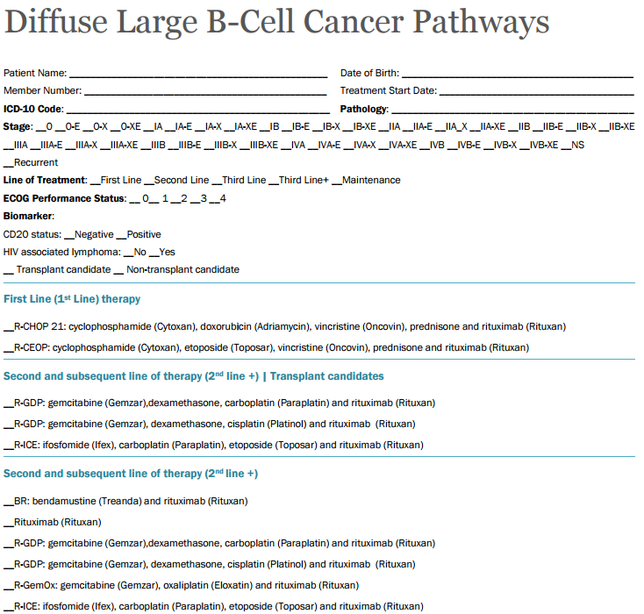
Oncology Pathways Example

Slide 62
Example 3:
Case Rates for HCT
Long history of use in transplant
Provides payment for set series of events during the course of a set number of days
Provides known spending amounts for payers, known resources for TC/program
Issue for HCT: Increasing need for additional outlier conditions and clauses
  Drug prices, donor cell costs

Slide 63
Emerging Technologies and Reimbursement
Pursuing new reimbursement models for “curative therapies”
Gene therapy as a model- “Glybera”
Curative:
  Innovative and one-time or short-term
  Delivered via irreversible process
  Significant (multi-year) effect
Tapestry Network, Building Sustainable Healthcare System for Curative Therapies Viewpoint, 2016

Slide 64
Proposed Payment Solutions for Curative Care
Consumer Mortgages
In-house lending by manufacturers
Amortization
Reinsurance
Patient-level wrap-around insurance
Annuities – pay for each year that it works
Bonds for local/national governments

Slide 65
Unknown:
How will HCT fit into this space?
If new cell therapy products are bridge to HCT, will the episodes/case rates be extended to include it?
(Could represent dramatic increase in expenditures)
Will financial toxicity increase as families try various treatments with new payment mechanisms?
Will these new therapies face reporting and accreditation requirements similar to HCT?

Slide 66
Questions to the Group
Are there actionable items here?
  Develop a research agenda around waste/inefficiency in HCT?
  Integrate HCT into clinical pathways?
  Identify methodology concerns with new CMS payment models?
  Propose a bundled payment to CMS for HCT?

