Slide 1
Hematopoietic Cell Transplantation: Moving Beyond Survival to the Patient’s Perspective Linda J Burns, MD Medical Director, NMDP/Be The Match Health Services Research Program October 19, 2017 2016 Quality and Value in HCT Forum
Acknowledgement. This program was partially funded through a Patient-Centered Outcomes Research Institute (PCORI) Eugene Washington PCORI Engagement Award (EAIN-2956).

Slide 2
Financial Disclosures
In accordance with ACCME®, standards for Commercial Support Number 6, all in control of content disclosed any relevant financial relationships. The following in control of content had no relevant financial relationships to disclose
Name | Role
Linda Burns, MD | Speaker

Slide 3
Learning objectives
Describe the NMDP’s patient-centered outcomes award and goals
Explain pilot protocol results assessing feasibility and value added of including patient reported outcomes (PRO) in the CIBMTR outcomes database

Slide 4
Why focus on the patient’s perspective?
Historically, HCT community has focused on research to improve the potential for survival
We have much more research to do in understanding patients’ perspectives of what outcomes, other than survival, matter to them, and how to measure them

Slide 5
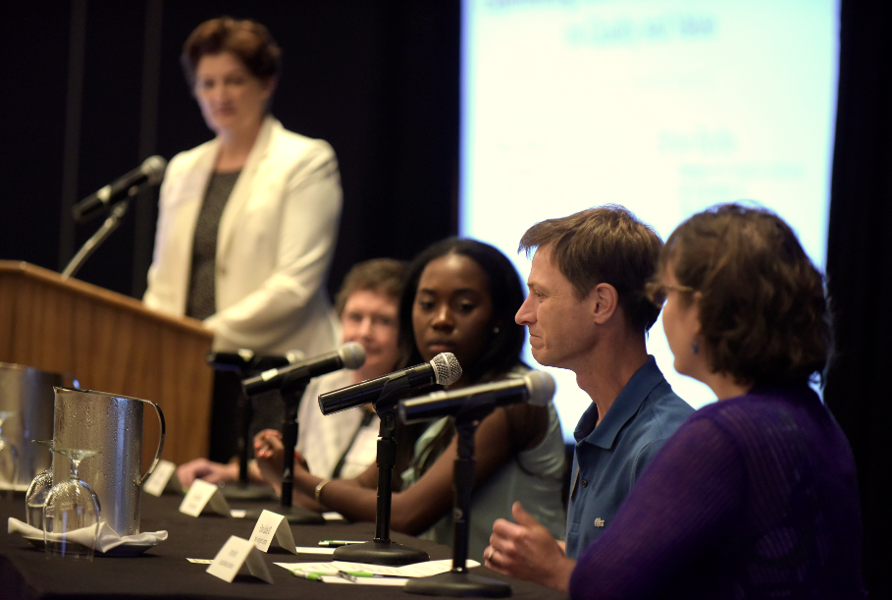
2015 Quality and Value Forum Patient and Caregiver Panel
Over 100 attendees
Patients
Physicians
Payers
TC administrators
Researchers
ASBMT, NMDP/Be the Match, CIBMTR, FACT, ASH, ACS
OUTCOMES:
Recognition that research in patient-centered outcomes is of high and immediate priority
“Call to action” by the NMDP Health Services Research Program for funding for PCOR

Slide 6
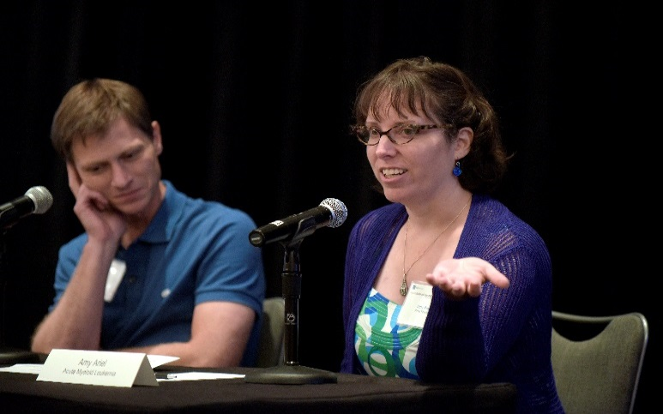
Patient-Centered Outcomes Research (PCOR)
Research that addresses the questions, concerns and outcomes that matter most to:
PATIENTS

Slide 7
@PCORI
Independent, nonprofit organization
Authorized by Congress in 2010
Mission: Fund research that provides patients, their caregivers, and clinicians with evidence-based information needed to make better-informed healthcare decisions
Engagement: Committed to continually seeking input from a broad range of stakeholders
http://www.pcori.org/

Slide 8
NMDP’s PCORI Engagement Award Engaging Patients in Developing a Patient-Centered Hematopoietic Cell Transplant Research Agenda
Three specific aims:
Recruit and engage a broad community of patients and other key stakeholders interested in PCOR in HCT
Identify and prioritize HCT-related patient-centered outcomes that will inform the development of an HCT PCOR agenda
Communicate and promote the HCT PCOR agenda to all stakeholders
Long term: build HCT PCOR capacity; leverage partnership to advance research agenda

Slide 9
Two-Year Work Plan
Symposium 1
Tandem
Feb 20, 2016
Honolulu
Symposium 2
Pre-ASH
Dec 2, 2016
San Diego
Symposium 3
Tandem
Feb 25, 2017
Orlando
Working Groups
Mar – Nov 2016
Dissemination
Webinars 1 & 2
Webinars 3 & 4
Feb 2016 Jan 2018
STEERING COMMITTEE

Slide 10
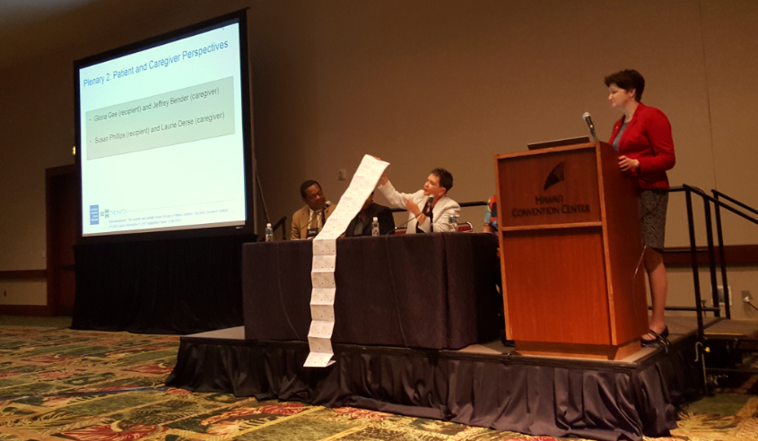
Symposium 1 Tandem
Setting the Stage
February 2016
Goals:
Engage key stakeholders interested in PCOR
Provide an educational foundation for our initiative and PCOR
Identify priority areas of research interest to establish Working Groups
Partial list of prescriptions this recipient takes

Slide 11
Working Groups: Composition and Tasks
Populated with representatives from all stakeholders
Tasks:
Identify gaps in knowledge in their focus area
Prioritize research questions with emphasis on comparative effectiveness research (CER)
Co-chairs:
Written report and PowerPoint presentation for Symposium 2

Slide 12
Working Groups: Six Key Areas
Patient, caregiver and family education and support
Physical health and fatigue
Emotional, cognitive and social health
Sexual health and relationships
Models of care delivery/survivorship and late effects
Financial burden

Slide 13
Symposium 2: Prioritizing a PCOR HCT Research Agenda
Goals:
Obtain patient and caregiver perspective on engagement
Present Working Groups’ recommendations on high priority questions
Obtain feedback into prioritization of questions

Slide 14
Symposium 3: Building a PCOR Collaborative Community
Goals:
Communicate and promote the finalized PCOR HCT research agenda
Identify strategies for engaging non-researchers in PCOR
Review research opportunities within PCORI, NMDP/CIBMTR and the Blood and Marrow Transplant Clinical Trials Network
Promote national and international research collaboration in PCOR

Slide 15
Dissemination
Remain patient focused
Report results in manner understandable to patients and the lay public
Webinars
Newsletters; List serves
Informational links on websites

Slide 16
Dissemination
Scientific community
Webinars
Presentations at scientific meetings
Public policy forums
Published manuscript(s)
Major payer groups
Policy makers

Slide 17
Summary
PCOR is a priority for the HCT community
Patient/caregiver perspective is unique
Results of this initiative will be foundational for future trials in comparative effectiveness research to improve patient-centered outcomes

